Slide 1
Systematization of ERI document
Advisor : L.T.Duyen
Developer :N.T.V.Anh, N.T.Huong
Supporter : N.T.T.Vinh

Slide 2
AGENDA
1
2
3
4
Background
Action
Problem & Result
Next plan

Slide 3
Background
ER
ECAR
DSUM
….
Simple flow.
Only relate 1->2 dep’t.
Only record instruction & information of dep’t action.
ER
DSUM
Document Control system
ECAR
EQR
WI
WI
ECS
Clear flow.
Only 1 route & do not split into many cases.

Slide 4







Background
TL/TS MSD
Waiting issue
Waiting issue
Difficult when making ERI system
Waiting issue
Wait approve NPIS
01
Waiting check
Wait delivery part
Waiting check
Waiting check
Relate ¬ 30 dep’t
TL/TS MIP
TL/TS PE2
Waiting approve
Check request adjust
Waiting approve
Waiting approve
01
TL/TS PE1
TL/TS PQA
TL/TS MFE1/2/3
Charging confirm
Approve request adjust
Responsible check
Charging confirm
Relate ¬ 30 dep’t
Return to Issuer
Return request adjust
Responsible approve
Return to Issuer
PUR confirm ETA
Confirm adjust
Verify confirm
In house confirm ETA
PUR check ETA
Check confirm adjust
Verify check
In house confirm product
TL PKE
ERI Document
Verify approve
02
PUR approve ETA
Approve confirm adjust
In house check product
Not yet have flow for Making PO
Cancel
In house approve product
Return buyer
Return confirm adjust
TL/TS ASSY
02
PUR confirm cancel
Wait cancel PO NPIS
Return verify
Wait receive part
Not yet have flow for Making PO
Issuer confirm cancel
Cancel
Return to issuer
Finish
Confirm pre export PO
Finish
Cancel
CIS
Check pre export PO
Approve pre export PO
03
PUR
Wait export PO file
TL/TS MO
Flow running have multipe route
TL PPD
Wait issue PO
03
TL/TS PDC1
Return PUR
Flow running have multipe route
TL/TS MQA
Case Order Part Outside
Case Assembly
Case Production

Slide 5
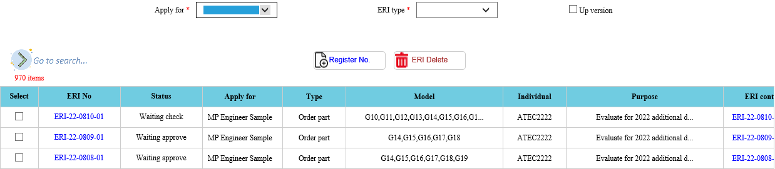
Action
MT Engineer
Sample
MP
Assembly
Apply for
MT
ERI Type
In-house
MP Engineer
Sample
Order part
Out side

Slide 6
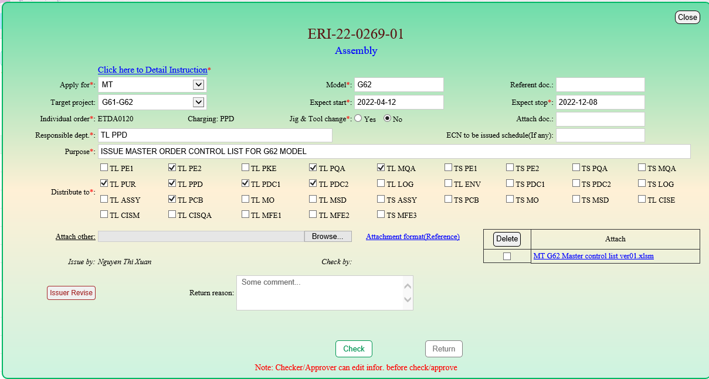
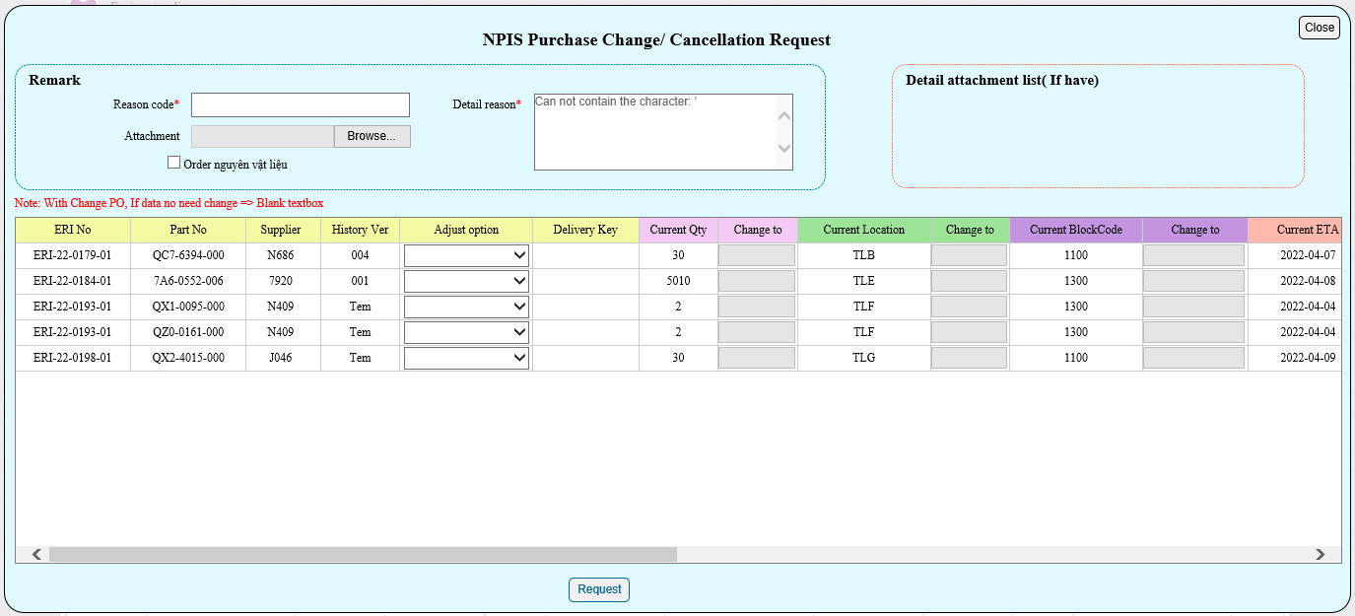
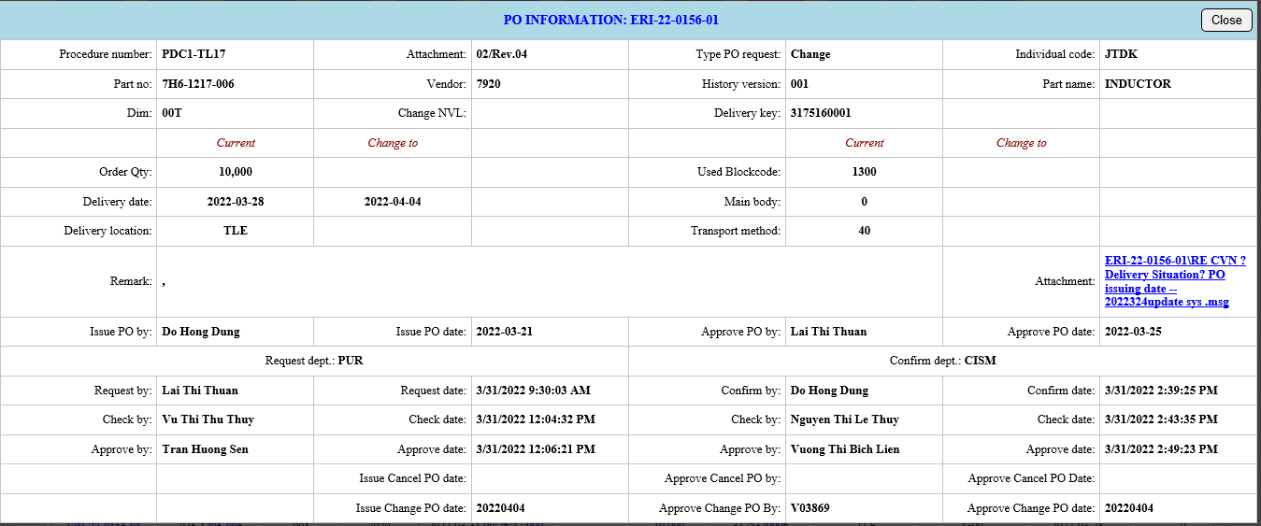
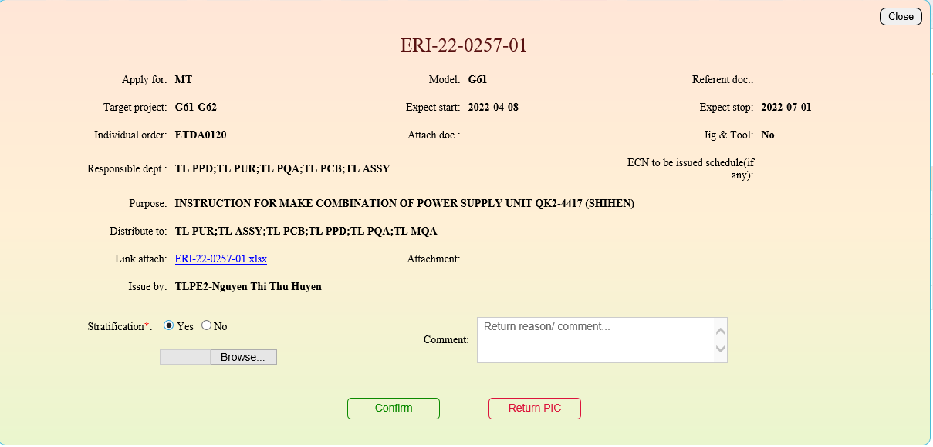
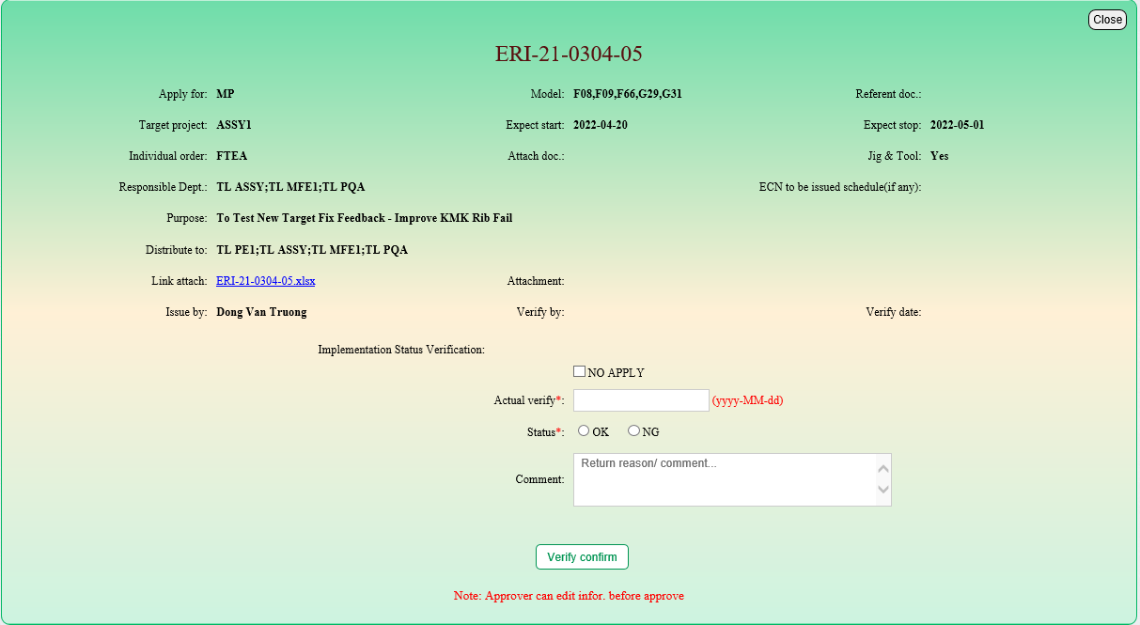
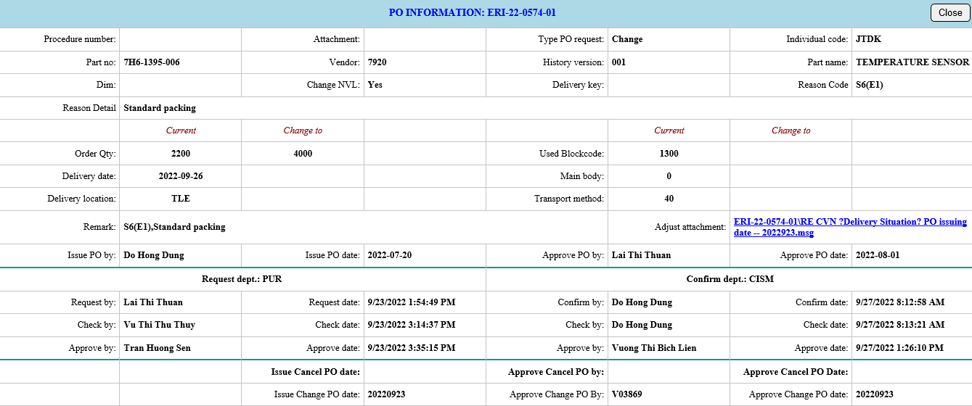
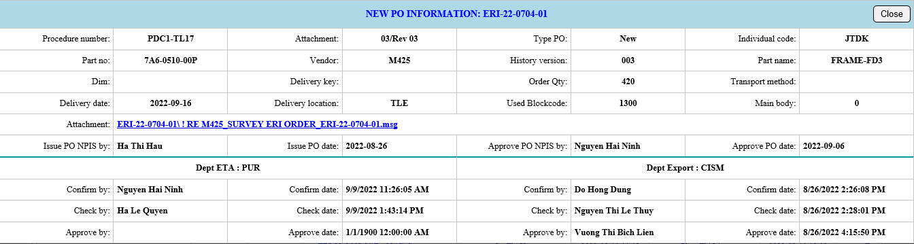
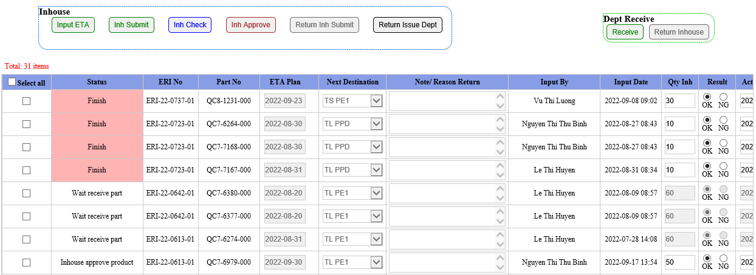
Action
Interface for ERI Order
Responsible dep’t
PO Control
Interface for Assembly
PE/CIS
issue
ERI system
PO History
Interface for History PO
Production
Interface for Production

Slide 7



Problem for PO Control
Problem
Risk point
Solution
1
PUR need show all history Adjust PO + new PO
Add new menu control History PO
2
Can’t auto link
Export file .csv for PPD/PDC1 upload when issue PO in NPIS
Differ data from NPIS & ERI system
3
> 25 steps (only case new PO)
User mistake
Wrong action
PRA
Tool Win form
4
Need using 2 system NPIS + ERI => Double Job

Slide 8
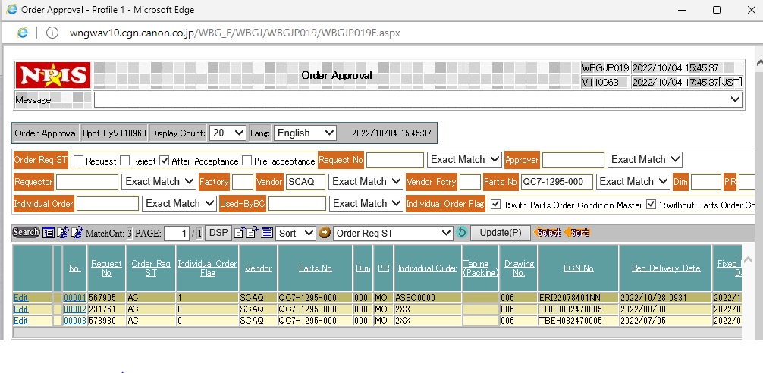
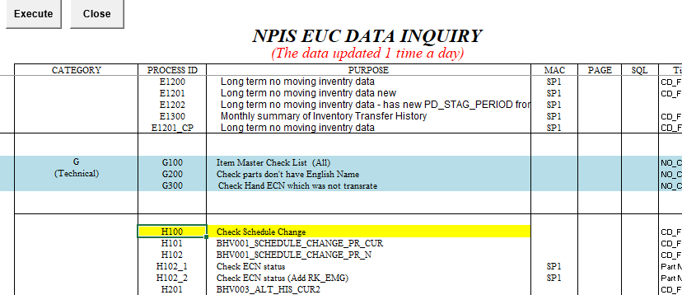



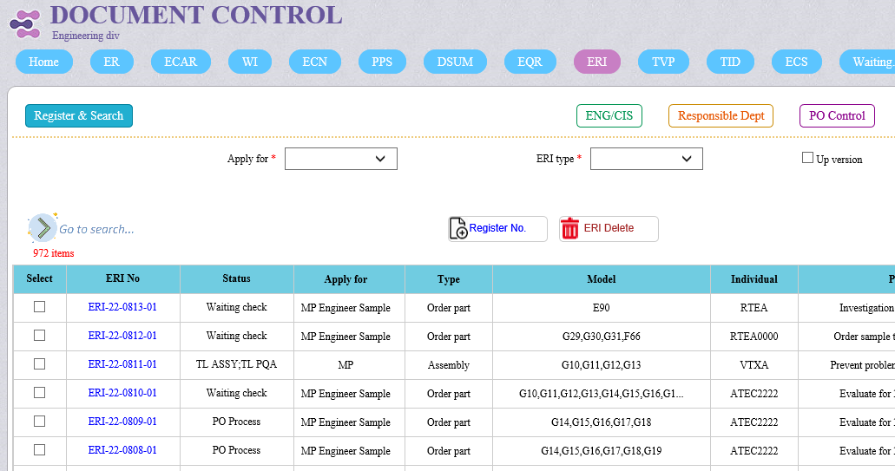
Auto link data ERI & NPIS
NPIS
EUC
Auto by robot + tool win form.
Cut 4 step PO.
Reduce 48 hours/ month.
ZERO risks, ZERO mistake.
Get data
Get data
RPA 1
RPA 2
Send data
Update data
ERI
Tool WF
Update data
Finish
Tool WF
Export format PO
Issue PO NPIS
Approve PO NPIS
Delivery part

Slide 9


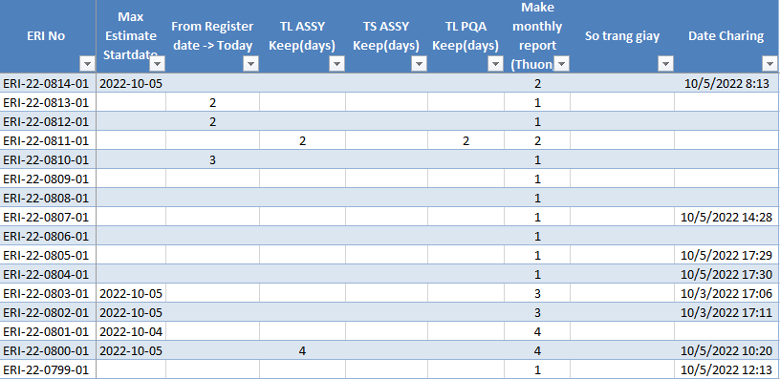


Problem from user
Problem
Risk point
Solution
User forgot to action on the system
Pending
Can not order part.
Line did not receive instructions to action.
Actual part # status of system.
Prevent over due date for each step

Slide 10
Remind ERI system
No | Step | Dept. | Lead time | Frequency
1 | PUR check ETA | PUR | 1 day | Daily
2 | PUR approve ETA |  | 1 day | Daily
3 | PUR confirm cancel |  | 3 days (after PE approve) | Daily
4 | Issuer confirm cancel | PE/CIS | 1 day | Daily
5 | Confirm pre export PO | PPD/PDC1/CIS PDC | 1 day (after PUR approve ETA) | Daily
6 | Check pre export PO
7 | Approve pre export PO |  | 1 day (after check pre export PO) | Daily
8 | Wait export PO file
9 | Wait issue PO
10 | Check request adjust PO | PPD/CIS/PDC1/PUR | 1 day | Daily
11 | Approve request adjust PO |  | 1 day | Daily
12 | Return request adjust PO |  | 1 day | Daily
13 | Confirm adjust PO |  | 1 day | Daily
14 | Check confirm adjust PO |  |  | Daily
15 | Approve confirm adjust PO |  | 1 day | Daily
16 | Return confirm adjust PO |  | 1 day | Daily
No | Step | Dept. - Category | Lead time | Frequency
1 | Issue | PE/CIS Order part | 1 day after register | Daily
2 | Check |  | 1 day | Daily
3 | Approve |  | 1 day | Daily
4 | Issue | PE/CIS Assembly | 1 day | Daily
5 | Check |  | 1 day | Daily
6 | Approve |  | 1 day | Daily
7 | Issuer confirm cancel | PE/CIS Assembly | 1 day | Daily
8 | Confirm verify |  | 1 day | Daily
9 | Approve verify |  | 1 day | Daily
For Issue Dep’t: PE/CIS
Total: 34 steps
Using 5 tool remind
For PUR/PPD/PDC1
PO Progress
No | Step | Dept. | Lead time | Frequency
1 | In-house input ETA plan | In-house depts. | 1 day | Daily
2 | In-house submit production report |  | 1 day after plan | Daily
3 | In-house check production report |  | 1 day | Daily
4 | In-house approve production report |  |  | Daily
5 | Receive dept. receive part | Receive dept. | 1 day | Daily
For In-house. Order part
For Responsible dep’t (Assembly)
No | Step | Dept. | Lead time | Frequency
1 | Responsible check | Responsible | 2 day | Daily
2 | Responsible approve |  | 1 day | Daily
No | Step | Dept. | Lead time | Frequency
1 | PUR confirm ETA | PUR | - 7 days if PUR not yet input ETA - If today >= Estimate date input ETA and not input ETA: remind change Estimate or input ETA | Daily mail

Slide 11
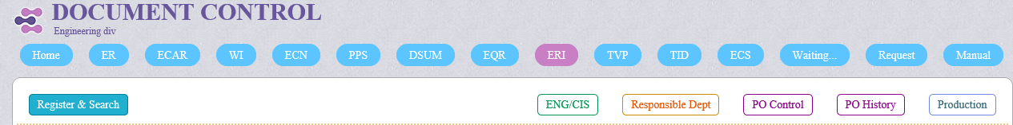
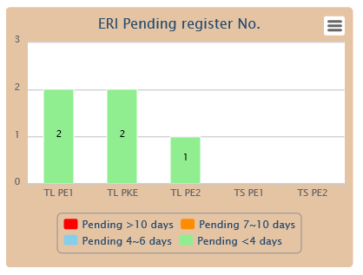
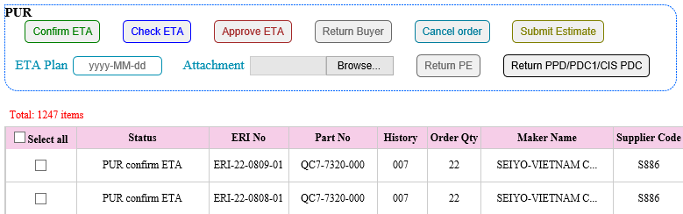
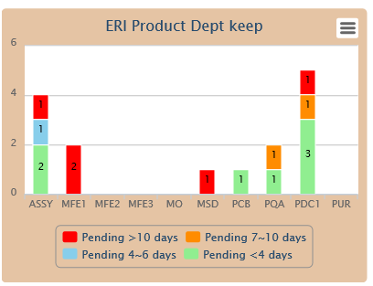
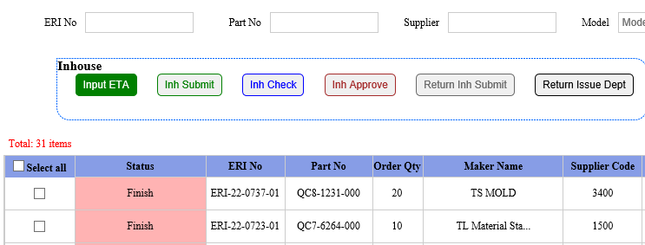
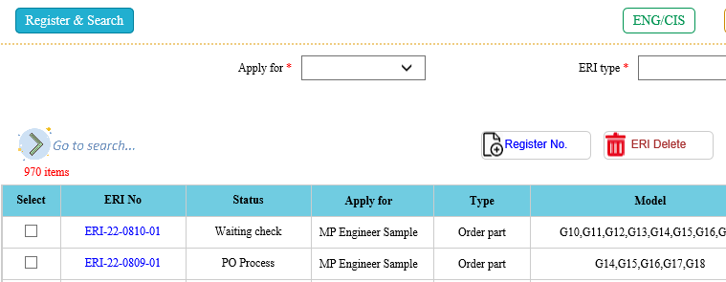
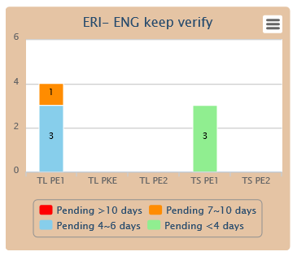
Result
Visualize
For Issue Dep’t
Order part out source
Order part in-house
For Responsible Dep’t
Total ERI items
970+
1250+
For PE keep
31+

Slide 12


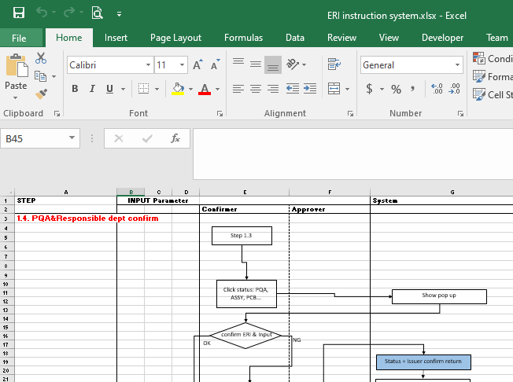

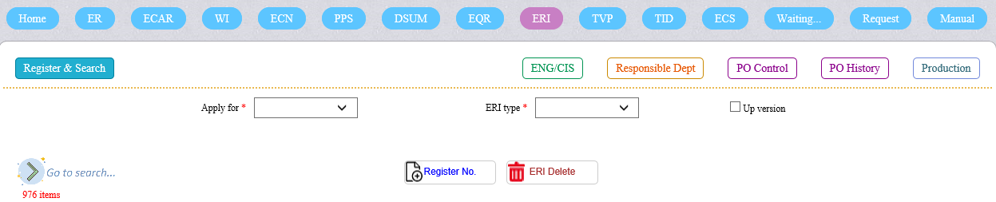
Merit
01
02
Cut step TIM scan
Reduce Time Reduce Cost
Boost Productivity
Work continuously
No need paper
High accuracy
03
04
Clear progress
=> Easy for manage
Reduce repetitive work
Increase user satisfaction

Slide 13

Next plan
Improve system
August-2022
04
17
March-2022
Trail running
07
Finish
02
Next year
05
ERI step 2
From | Idea content | Action
PQA | Request add step from PDC2 receive ERI part and MQA inspection to close | Related dep’t discuss and feedback TIM to implement step 2 of ERI system.
PQA | PQA request to add periodical verify after PE verify ERI | PQA make flow & discuss with related to & feedback TIM
Launching system
03
August-2021
March-2022
Start
01
22
21

Slide 14

Thank you!
Do you have any questions?

Slide 15


Background
02
01
Time
Paper (sheet)
Dep't action | Step | Time (minute)
PE | PE issue | 30
 | PE check | 20
 | PE approve | 5
TIM | TIM record excel file and distribute | 5
Charging dept | Confirm charging | 5
PUR | PUR confirm ETA | 35
 | PUR check ETA | 5
 | PUR approve ETA | 4
 | Request adjust PO | 36
 | Check request adjust PO | 5
 | Approve request adjust PO | 4
PDC1/PPD | Export & input PO file | 10
 | Issue PO on NPIS | 3
 | Inform PUR after issue PO | 2
 | Request adjust PO | 5
 | Check request adjust PO | 5
 | Approve request adjust PO | 5
 | Total time | 184
 | 2021 ERI q'ty | Page | Sheet
PE + Response dep’t (cover file) | 1096 | 2 | 2192
PUR + PPD/PDC1(PO new + adjust) | 2000 | 1 | 2000
PPD+PDC1 (Charging) | 63 | 2 | 126
Total |  |  | 4318
Easy to lose documents
Difficult for manage
Ex: case order part out side

